Slide 1

Big Data Analysis of Chicago Crime Records
How effectively data is analyzed stored and processed using different cloud based tools.
BIG DATA AND CLOUD COMPUTING –IT 5613
Presented by : CHARISHMA KATTA

Slide 2
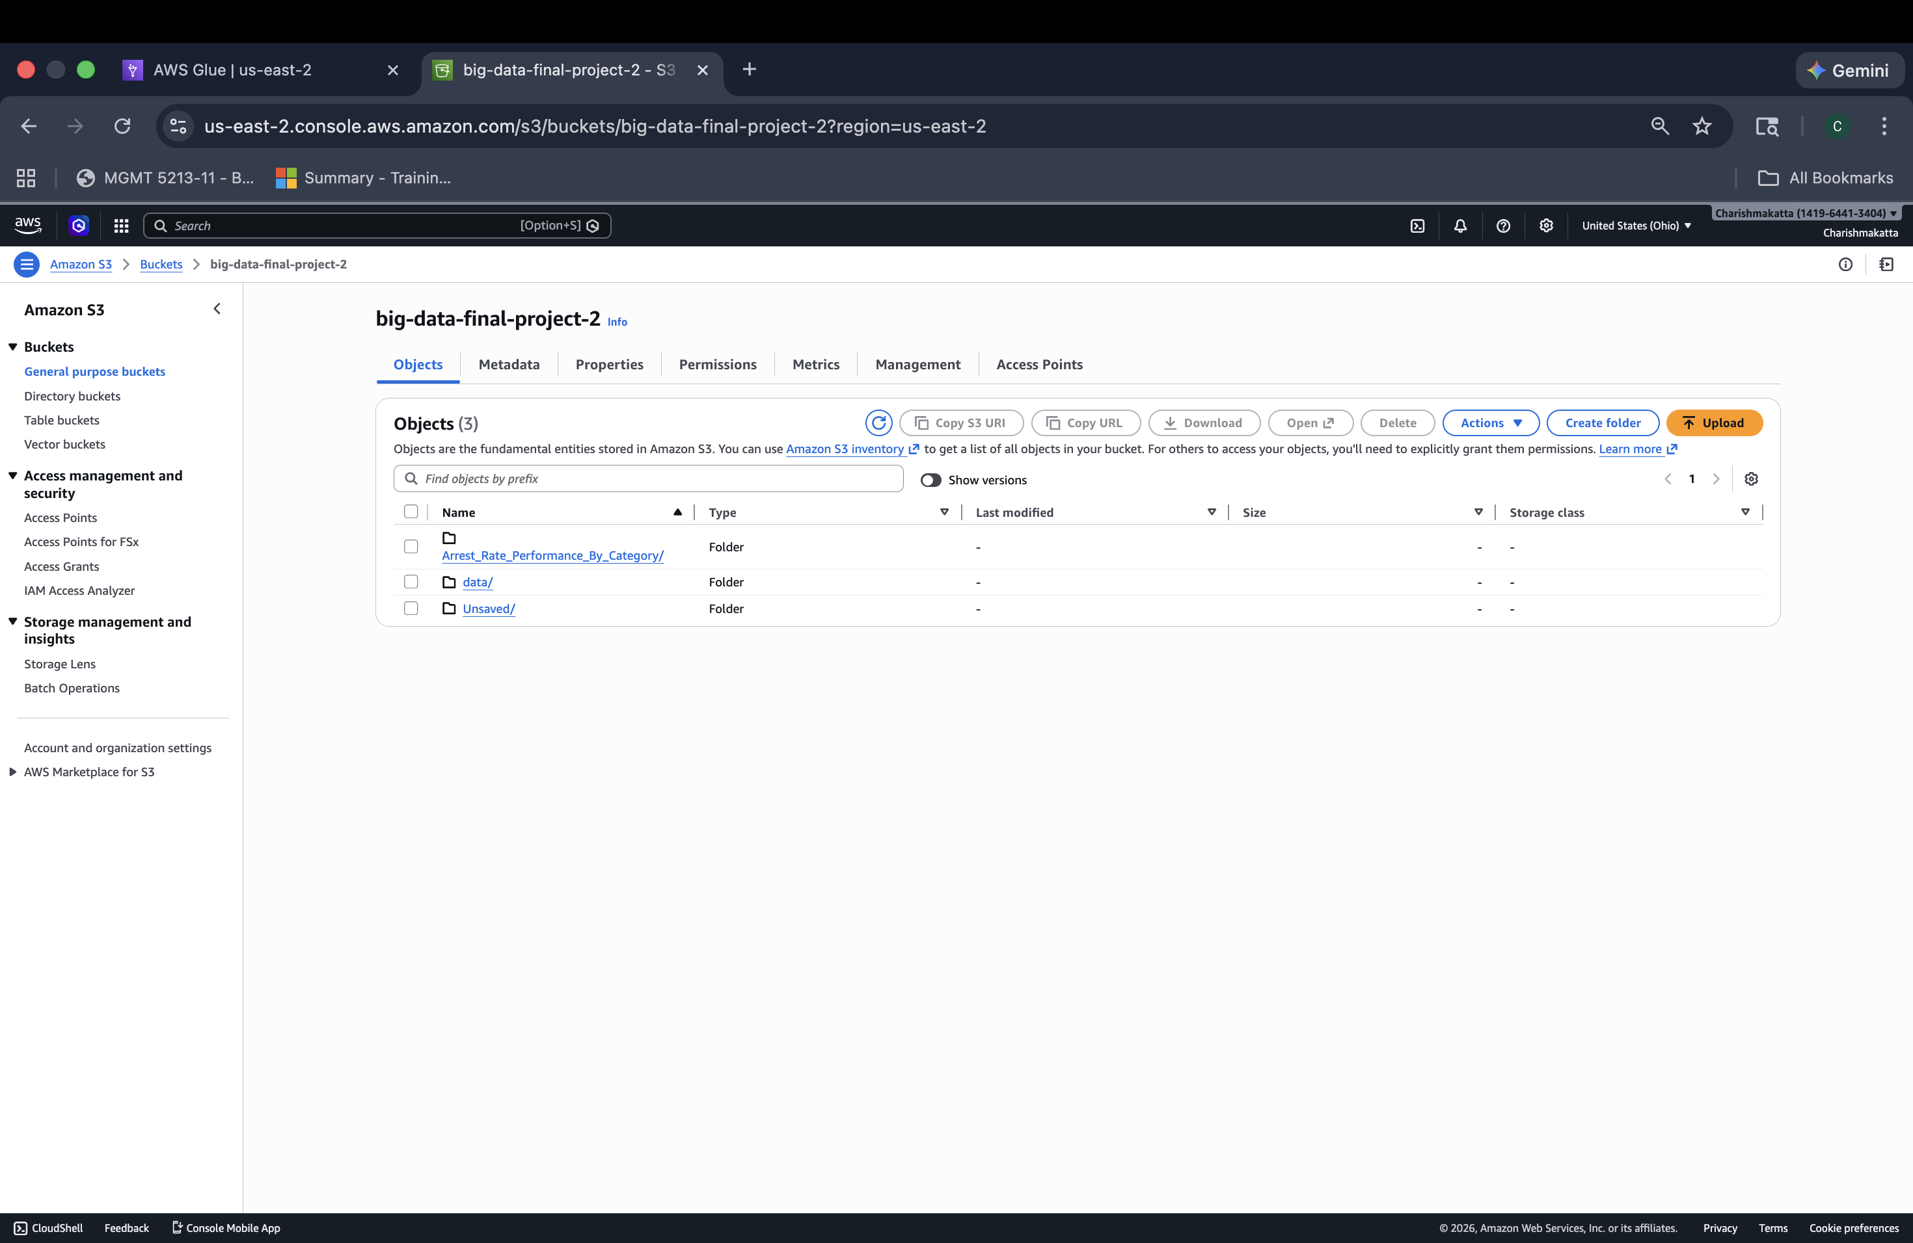
Data Storage & The Data Lake Concept
S3 is used here because it is highly scalable and it allows for Decoupled storage and compute.
A data lake is created here using Amazon S3 and the data csv file is uploaded into the bucket.

Slide 3
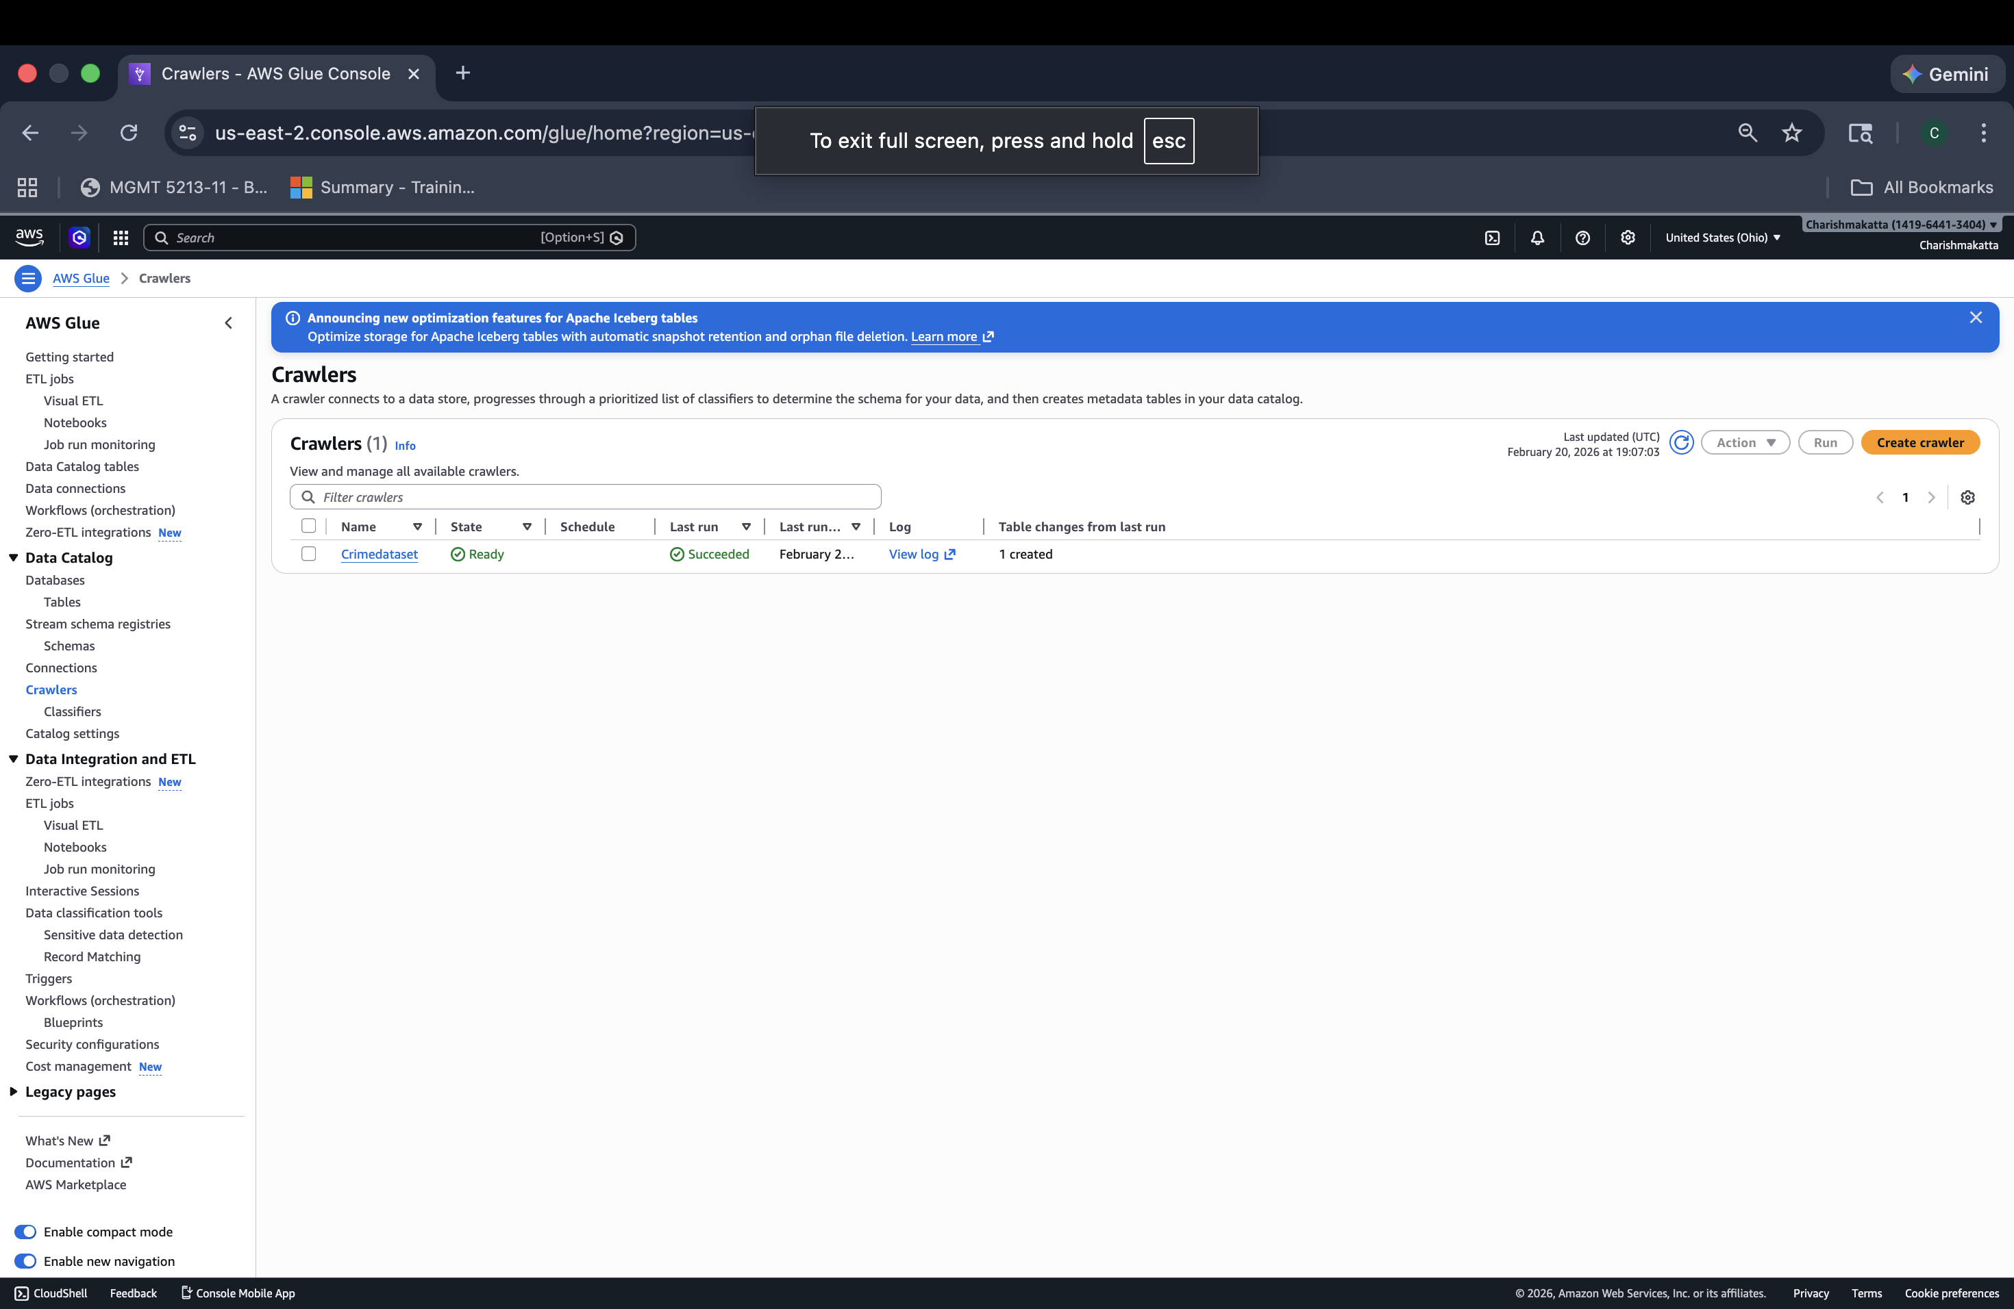
Metadata Discovery & Automation
This is the Discovery phase. Glue identifies the column headers and data types .
AWS services know how to read the raw file without us having to move the data.

Slide 4
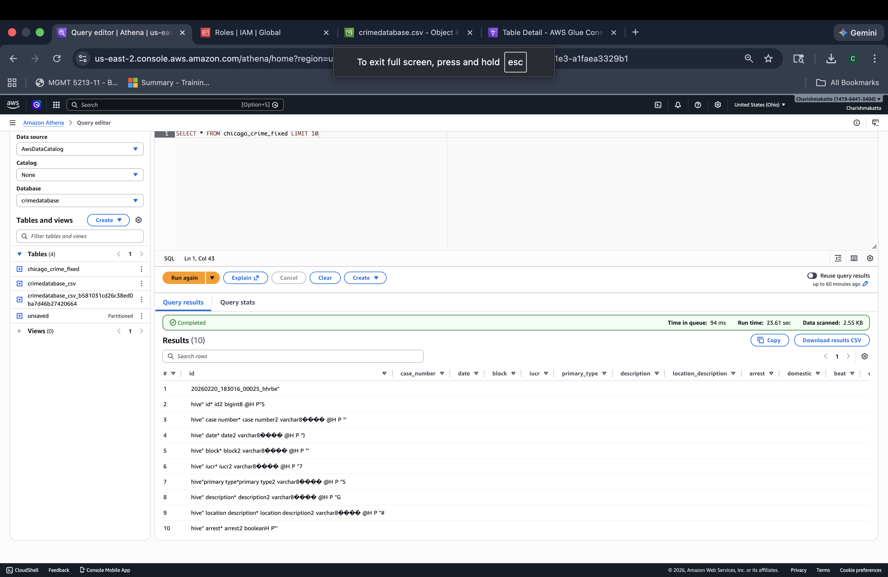
Troubleshooting Real-World Data
As seen in the screenshot, the initial query returned technical metadata (words like hive, bigint, varchar) instead of crime records.
The Crawler accidentally indexed hidden system files instead of just the CSV.

Slide 5
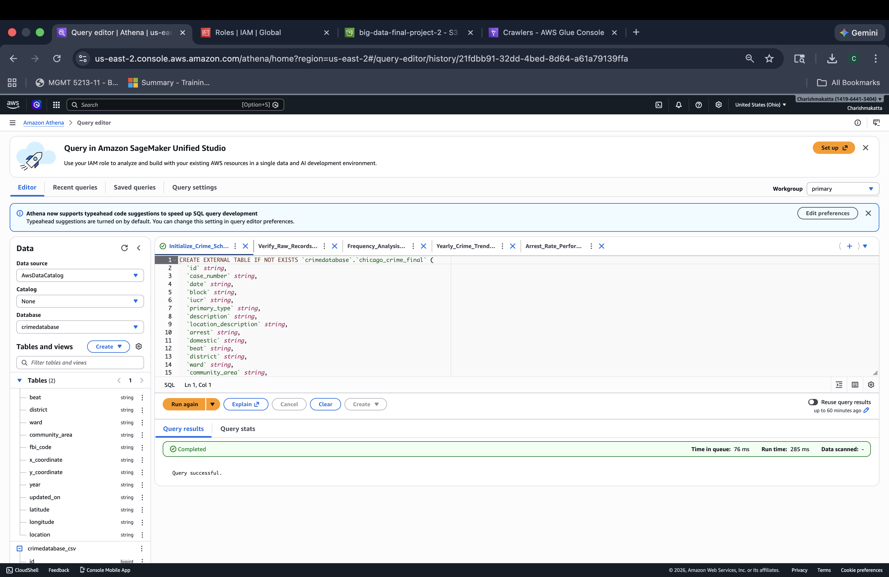
Data Engineering & Serialization
I wrote a custom SQL DDL script to manually create an "External Table." I used the OpenCSVSerde library.
I defined all columns as STRING. This was a strategic choice to handle "dirty data" (like empty coordinate fields) that was causing numeric parsing errors earlier.

Slide 6
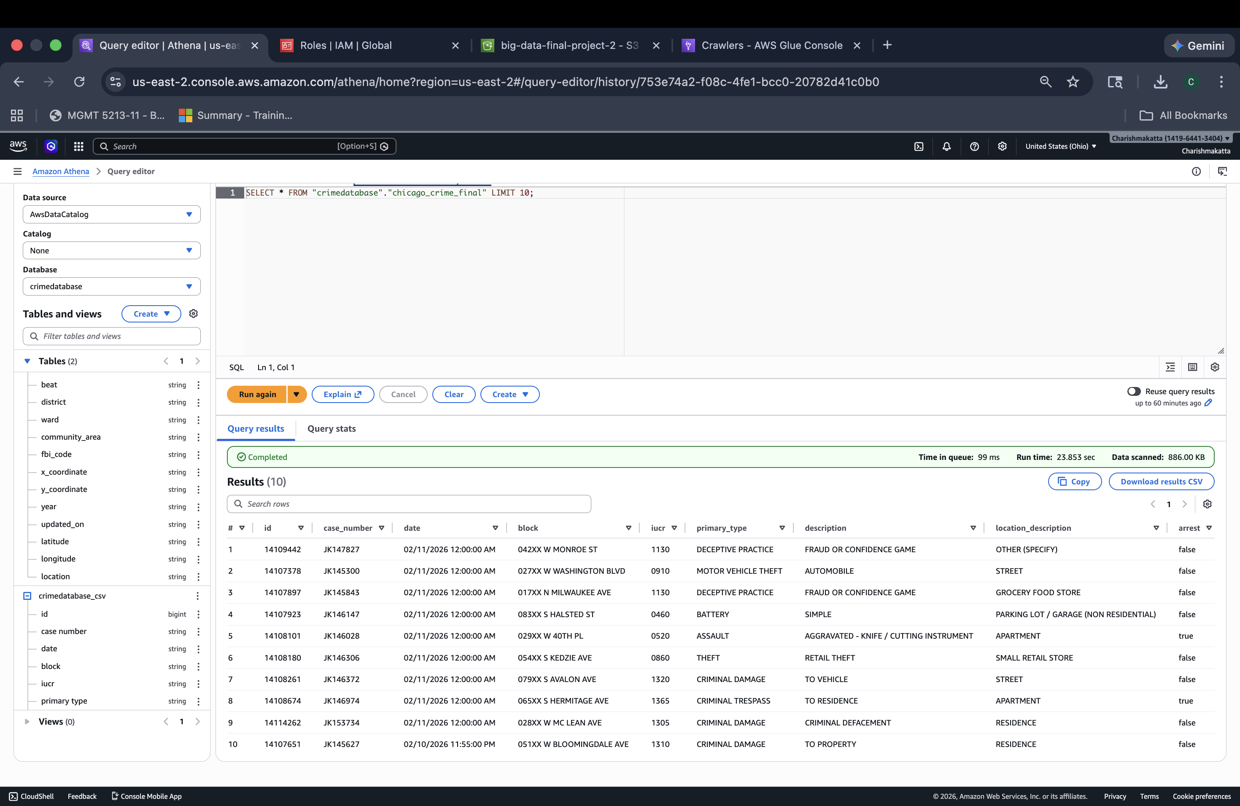
Data Validation
I ran a SELECT * LIMIT 10 query.
This screenshot proves the fix worked! You can now see actual crime descriptions like "THEFT" and "DECEPTIVE PRACTICE."
This confirmed that our Schema-on-Read was correctly mapped to the physical file in S3.

Slide 7
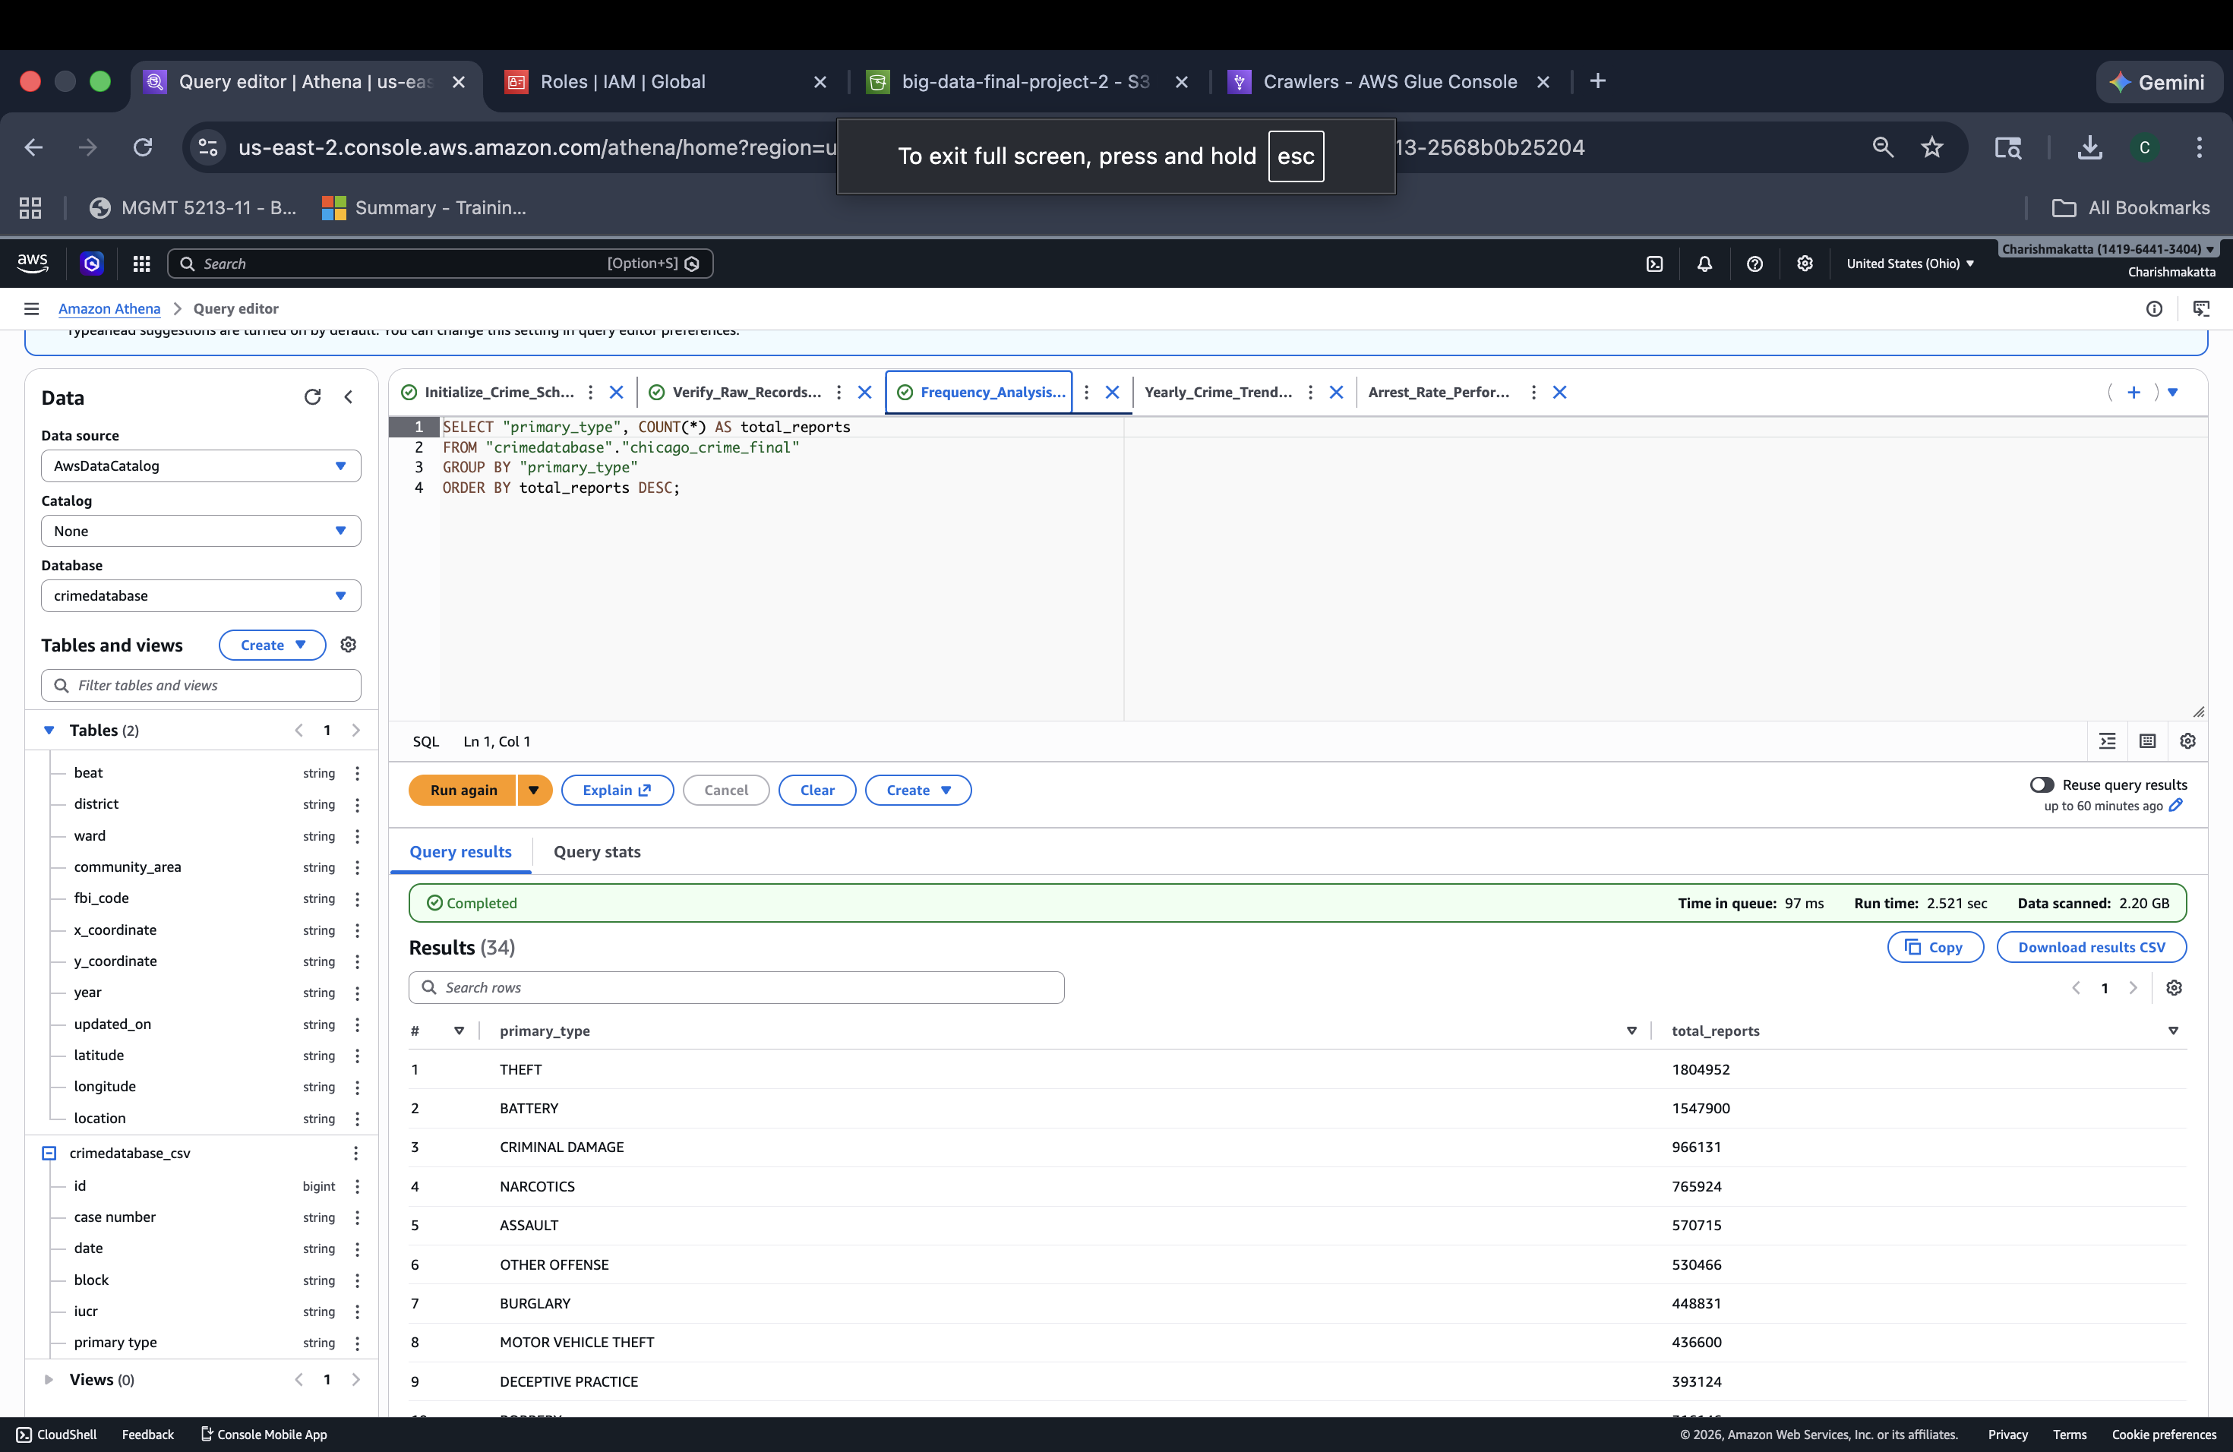
Frequency & Density Analysis
I used the COUNT and GROUP BY functions to aggregate the data by crime type.
This analysis identifies where the most pressure is on city resources. We discovered that Theft and Battery are the most frequent crimes in the dataset, totaling millions of records.

Slide 8
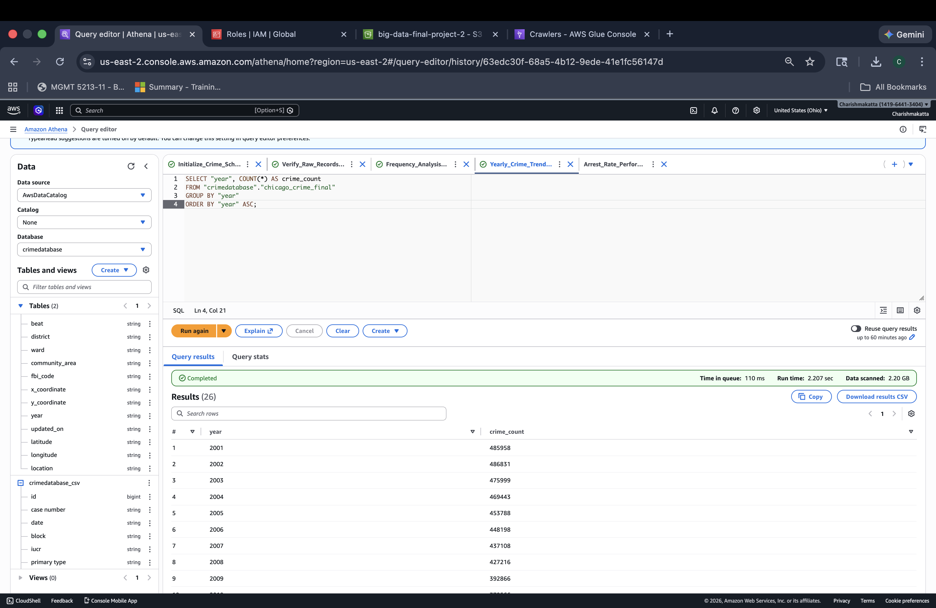
Temporal Analysis (Time Series)
I analyzed the crime volume per year from 2001 to the present.
This shows the "Big Data" trend over time. It allows us to see if crime is trending up or down, which is essential for high-level policy making and historical reporting.

Slide 9
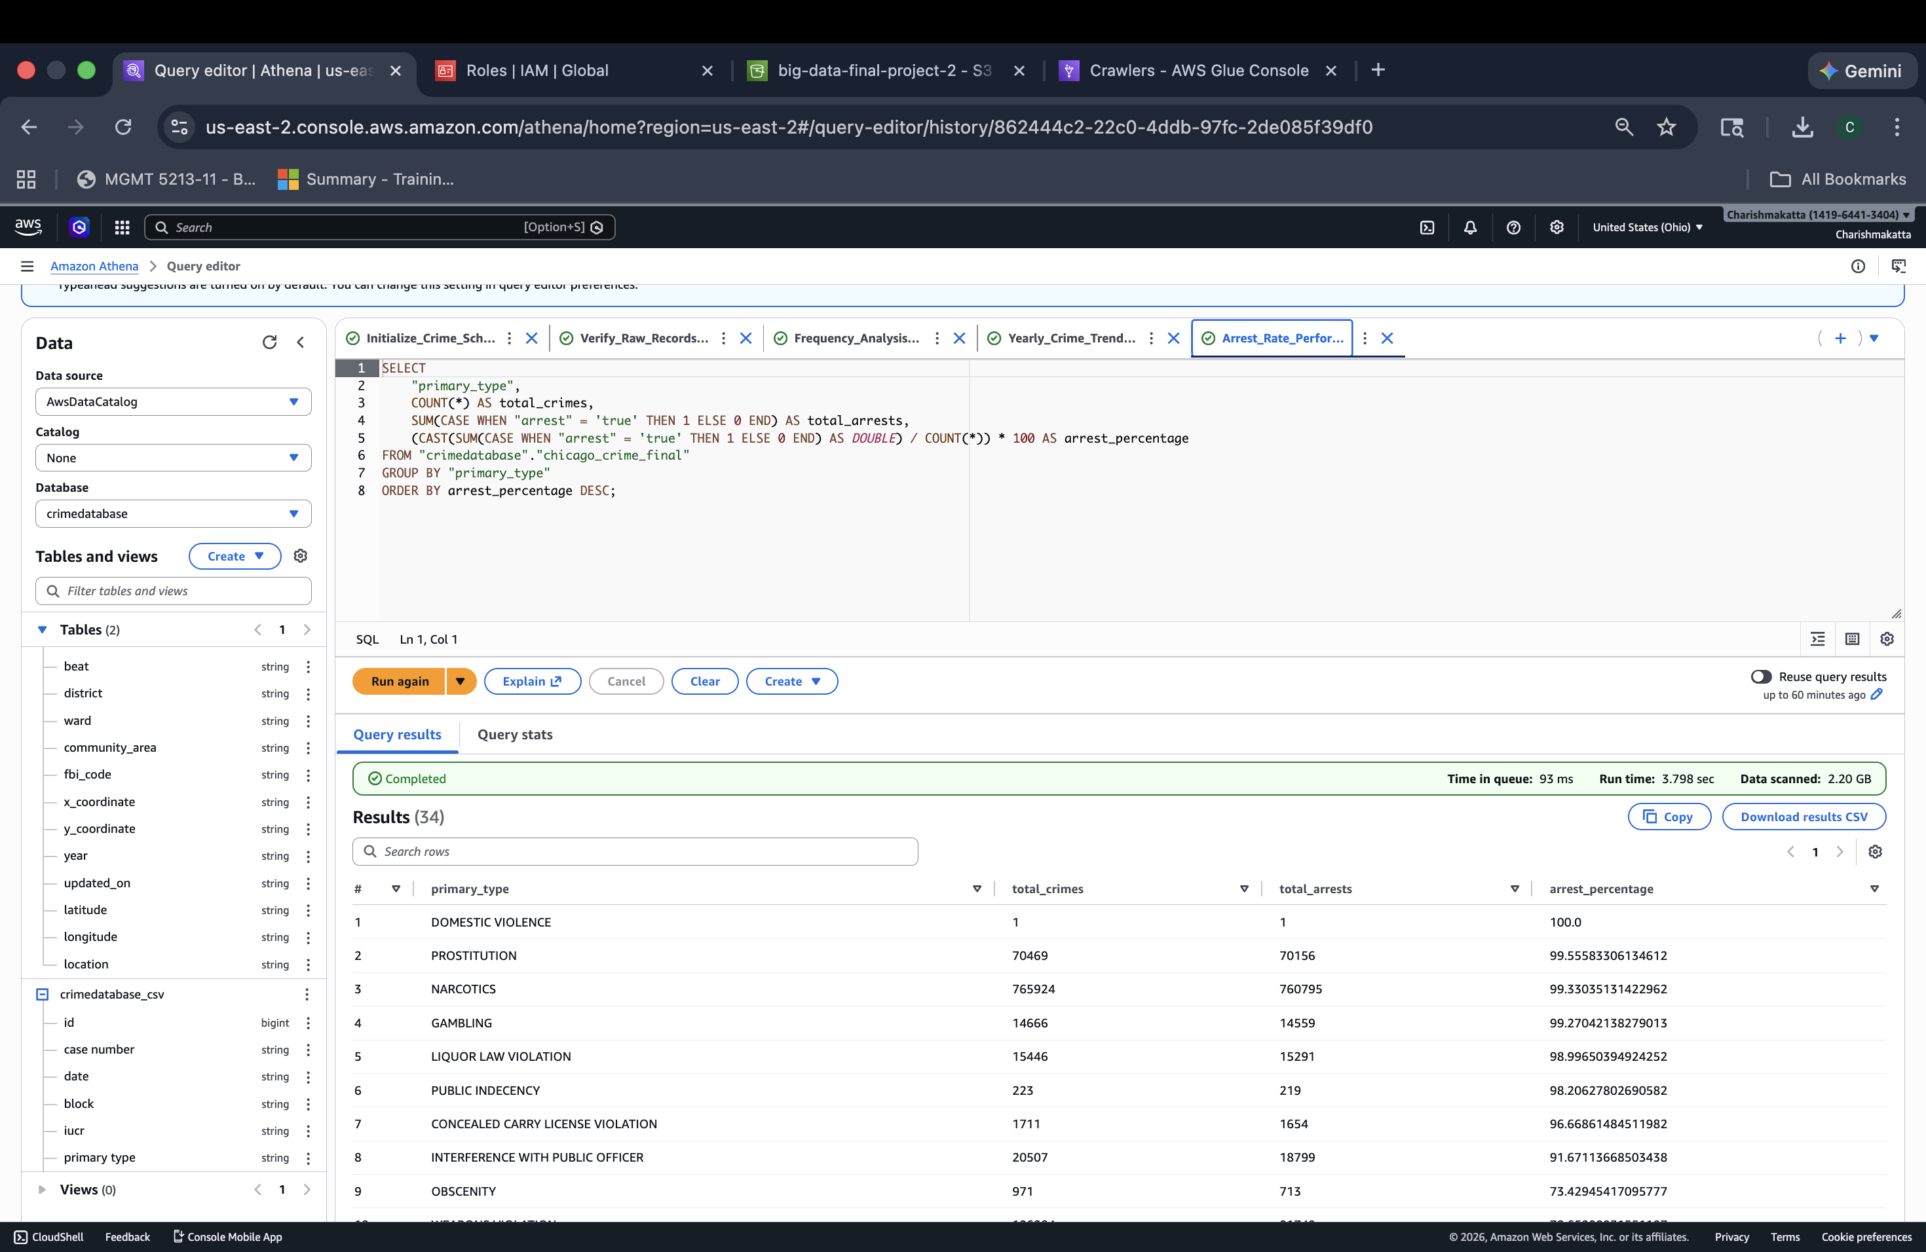
Performance Metrics (KPIs)
I calculated the Arrest Rate percentage for each crime type using CAST and SUM logic.
This is a key effectiveness metric. While some crimes like "Narcotics" have a near 100% arrest rate, others are much lower.
This identifies where law enforcement is most (and least) successful in closing cases.

Slide 10
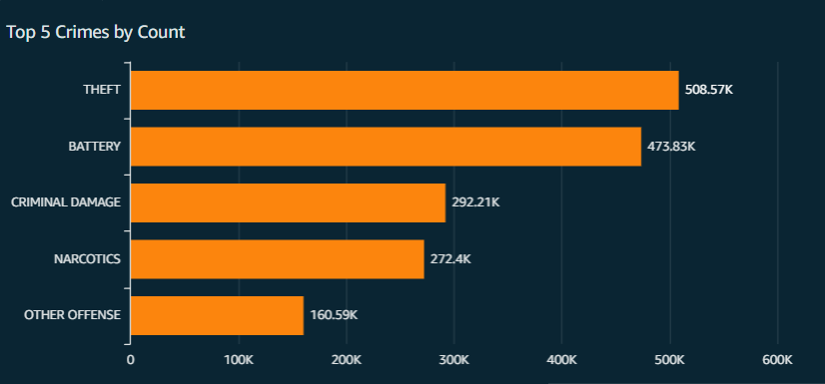
Data Visualization
Bar Chart (Top Crimes)

Slide 11
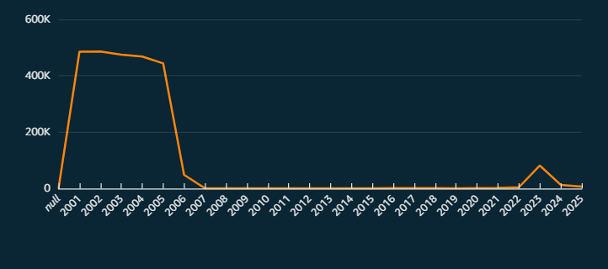
Data Visualization
Line Chart (Crimes by Year)

Slide 12
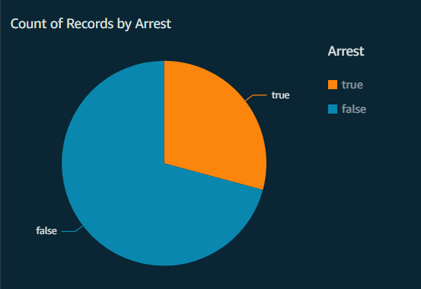
Data Visualization
PIE Chart (Total Arrests)

Slide 13
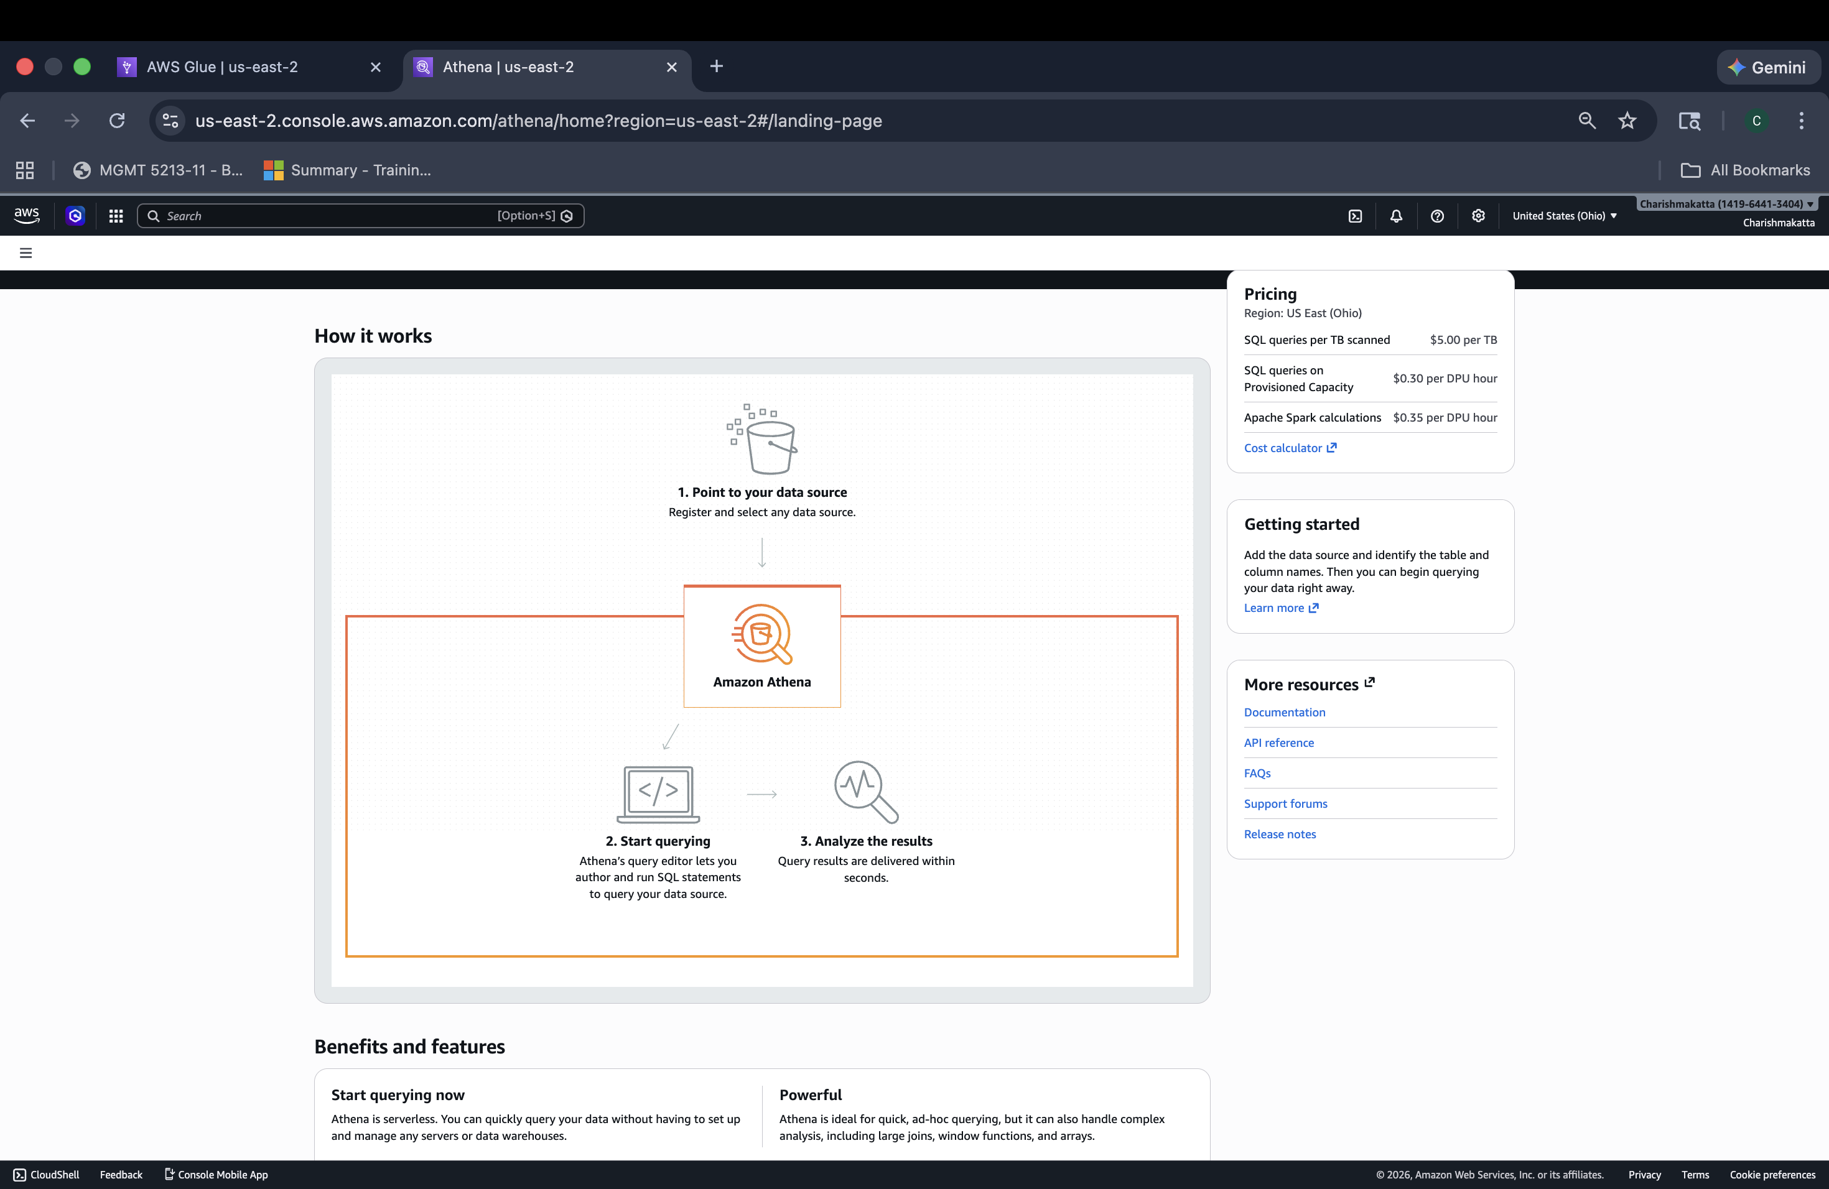
Conclusion: Serverless Analytics
We successfully built a Serverless Pipeline.
By using S3, Glue, and Athena, we processed millions of rows of data without ever having to manage a single server or database instance.

Slide 14

FUTURE WORK
Interactive Dashboards: Connect the data to Amazon QuickSight to create visual "Crime Heat Maps" and charts that city officials can use to spot trends instantly.
Predictive Policing: Use Amazon SageMaker (AI/ML) to predict where crimes are likely to happen next based on historical locations and times.
Real-Time Updates: Set up AWS Lambda to automatically update our analysis the second a new crime report is uploaded, moving from "monthly" to "live" data.
Cost Optimization: Organize the data into "folders" by Year or District (called Partitioning). This makes queries run 80% faster and reduces AWS costs.
Mobile Alerts: Create an automated system to send mobile notifications to district commanders when crime rates in their area spike above a certain threshold.

